Slide 1
Principles of big data management – project 3
Presented By:
Team 13
Sri Sai Anusha Gandu (sgr43)
Sushma Mitta (smgp6)
Sadanand Kallakuri (sk789)
Abhilash Reddy Gaddam (aggg6)

Slide 2
Query 1 (Using RDD)
Users who tweeted more from US state
Output obtained is the table of name and location of the user and the number of tweets from the particular user

Slide 3
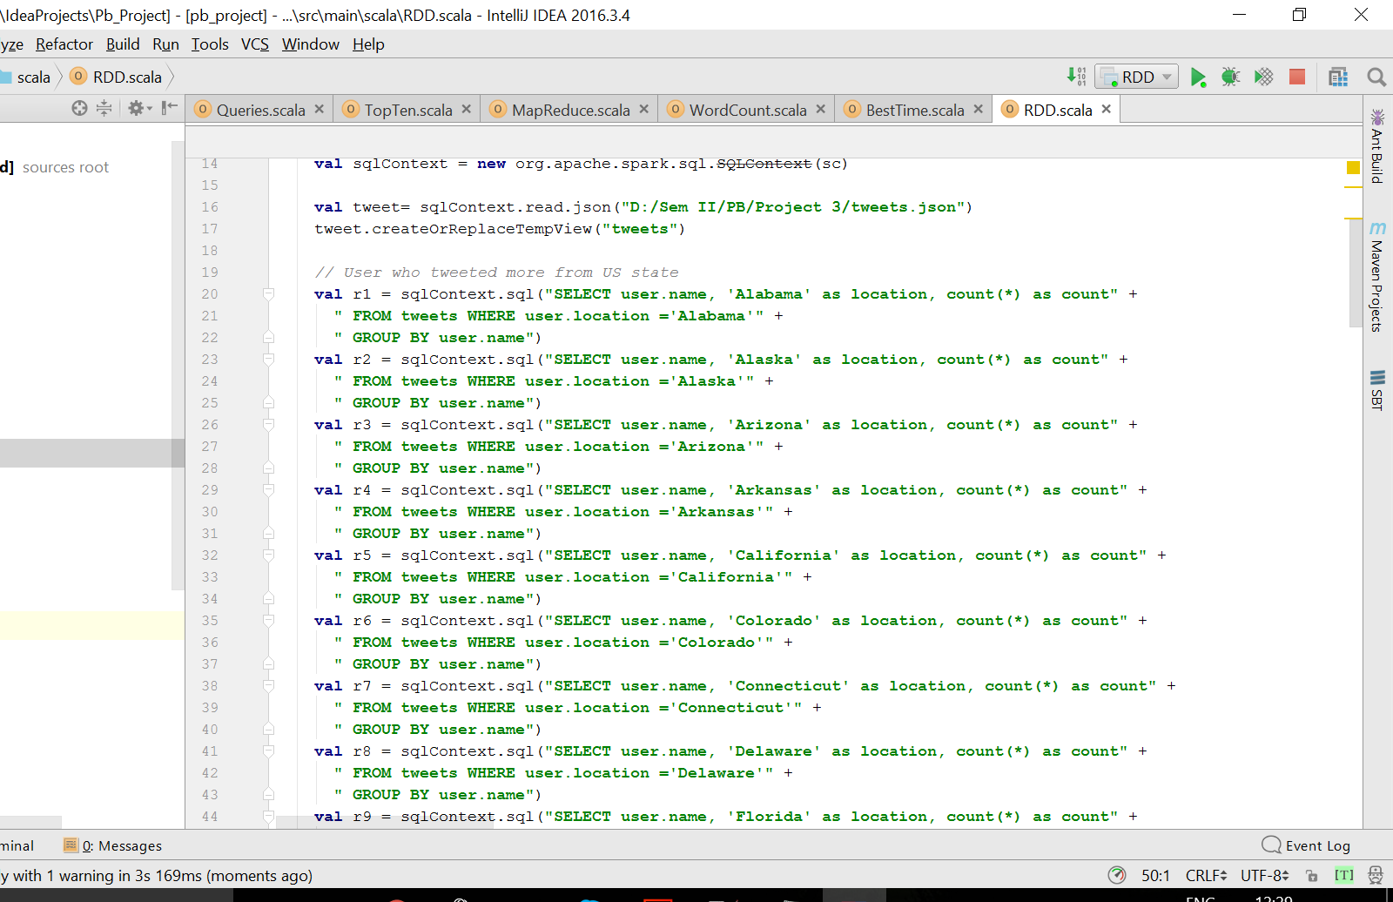

Slide 4
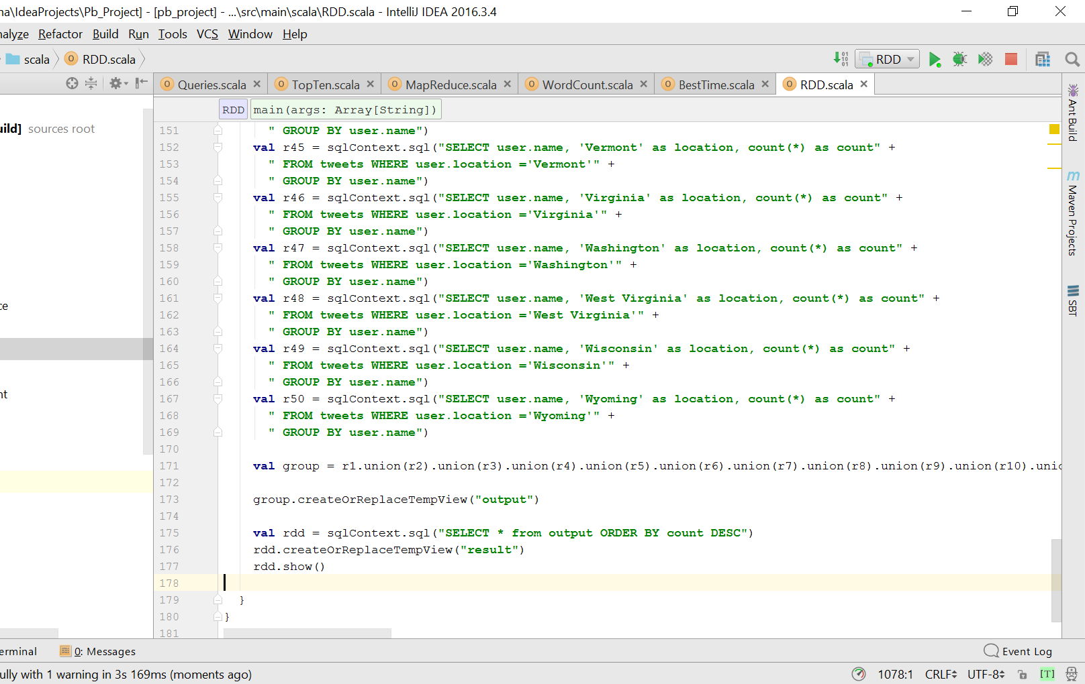

Slide 5
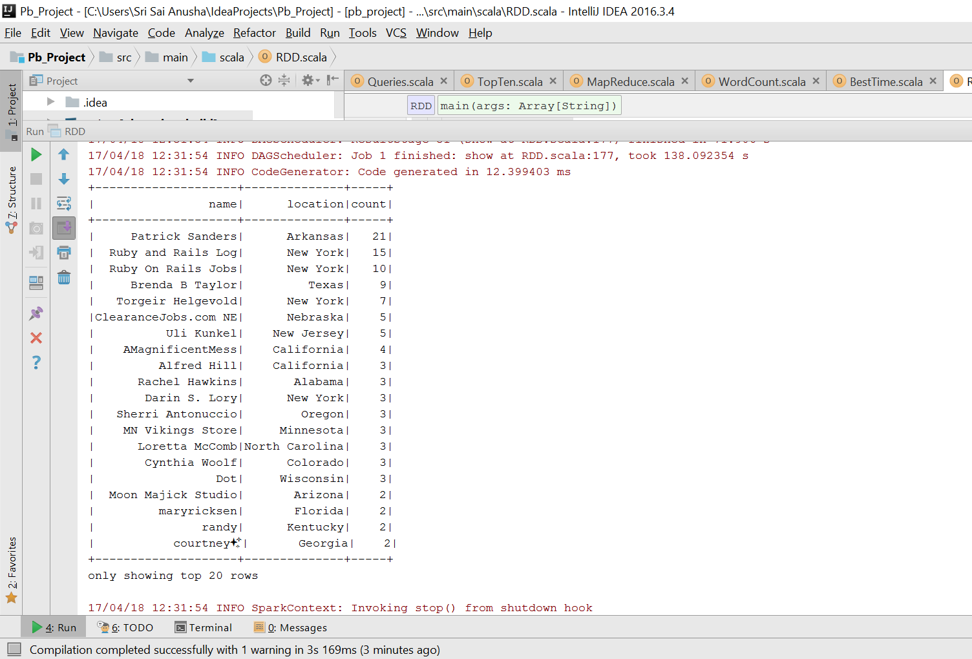

Slide 6
Query 2
Tweet count obtained from different locations
Output obtained is the location and the tweet count from the particular location

Slide 7
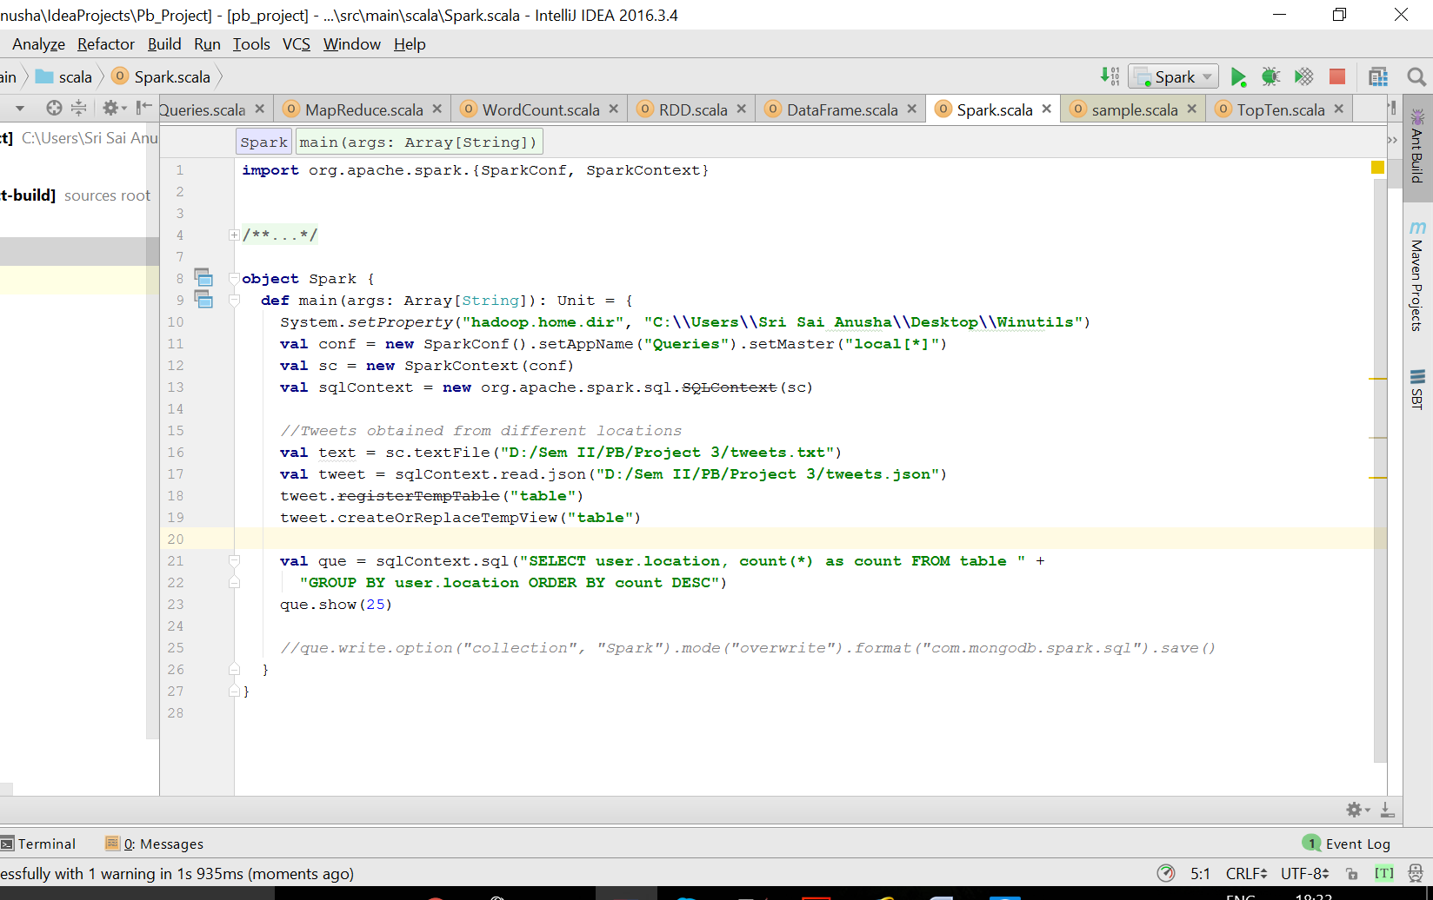

Slide 8
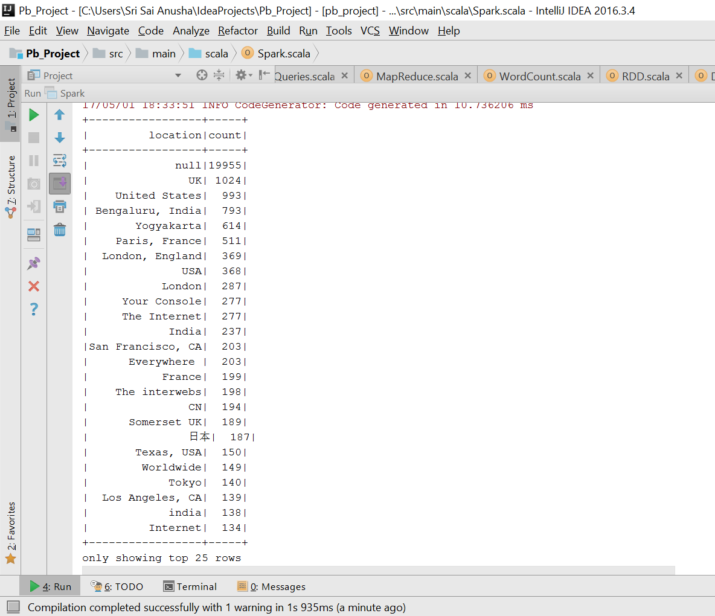

Slide 9
Query 3 (Using Trends File)
Searches through the names in trends file and gives out the text and hashtags of the common names in tweets file

Slide 10
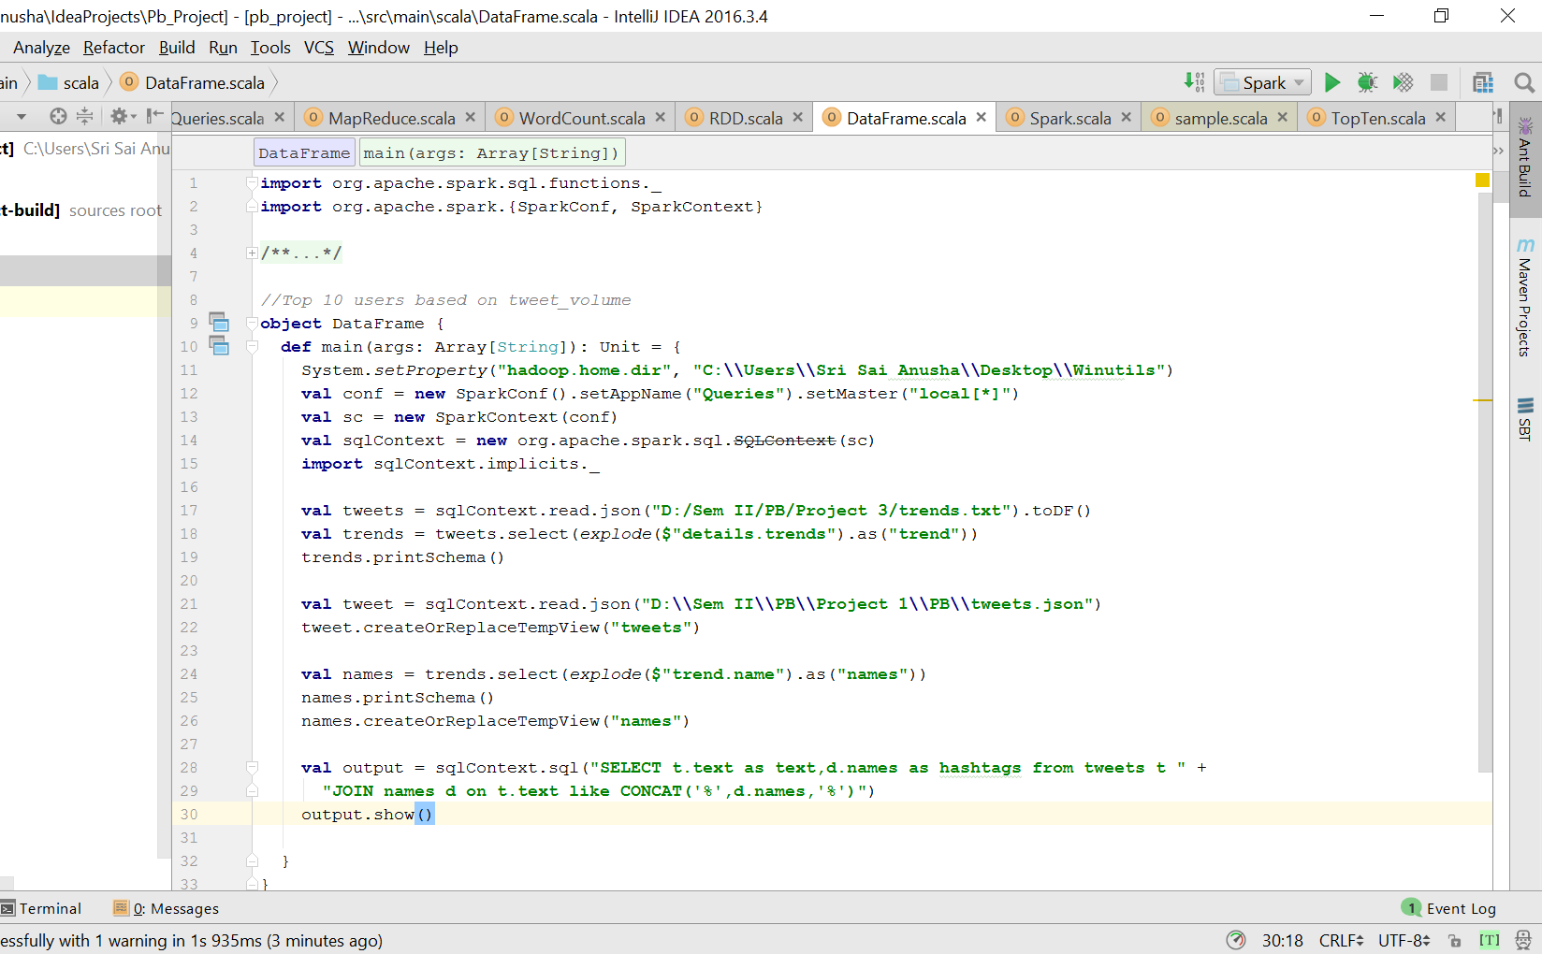

Slide 11
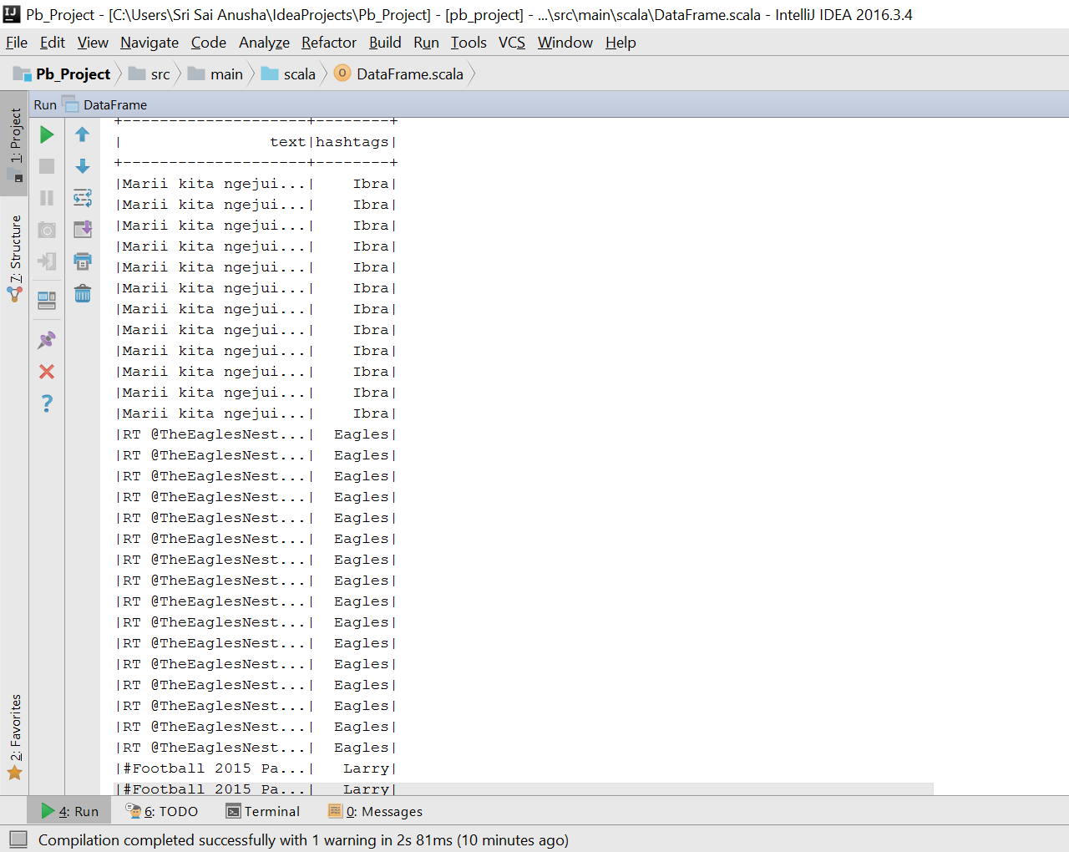

Slide 12
Extra Requirement
Visualizes the queries above and shows dynamic representation of the queries

Slide 13
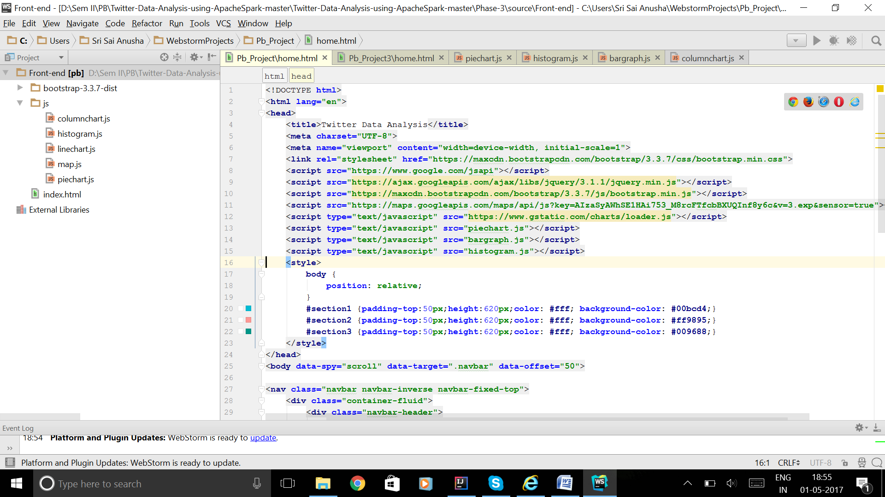
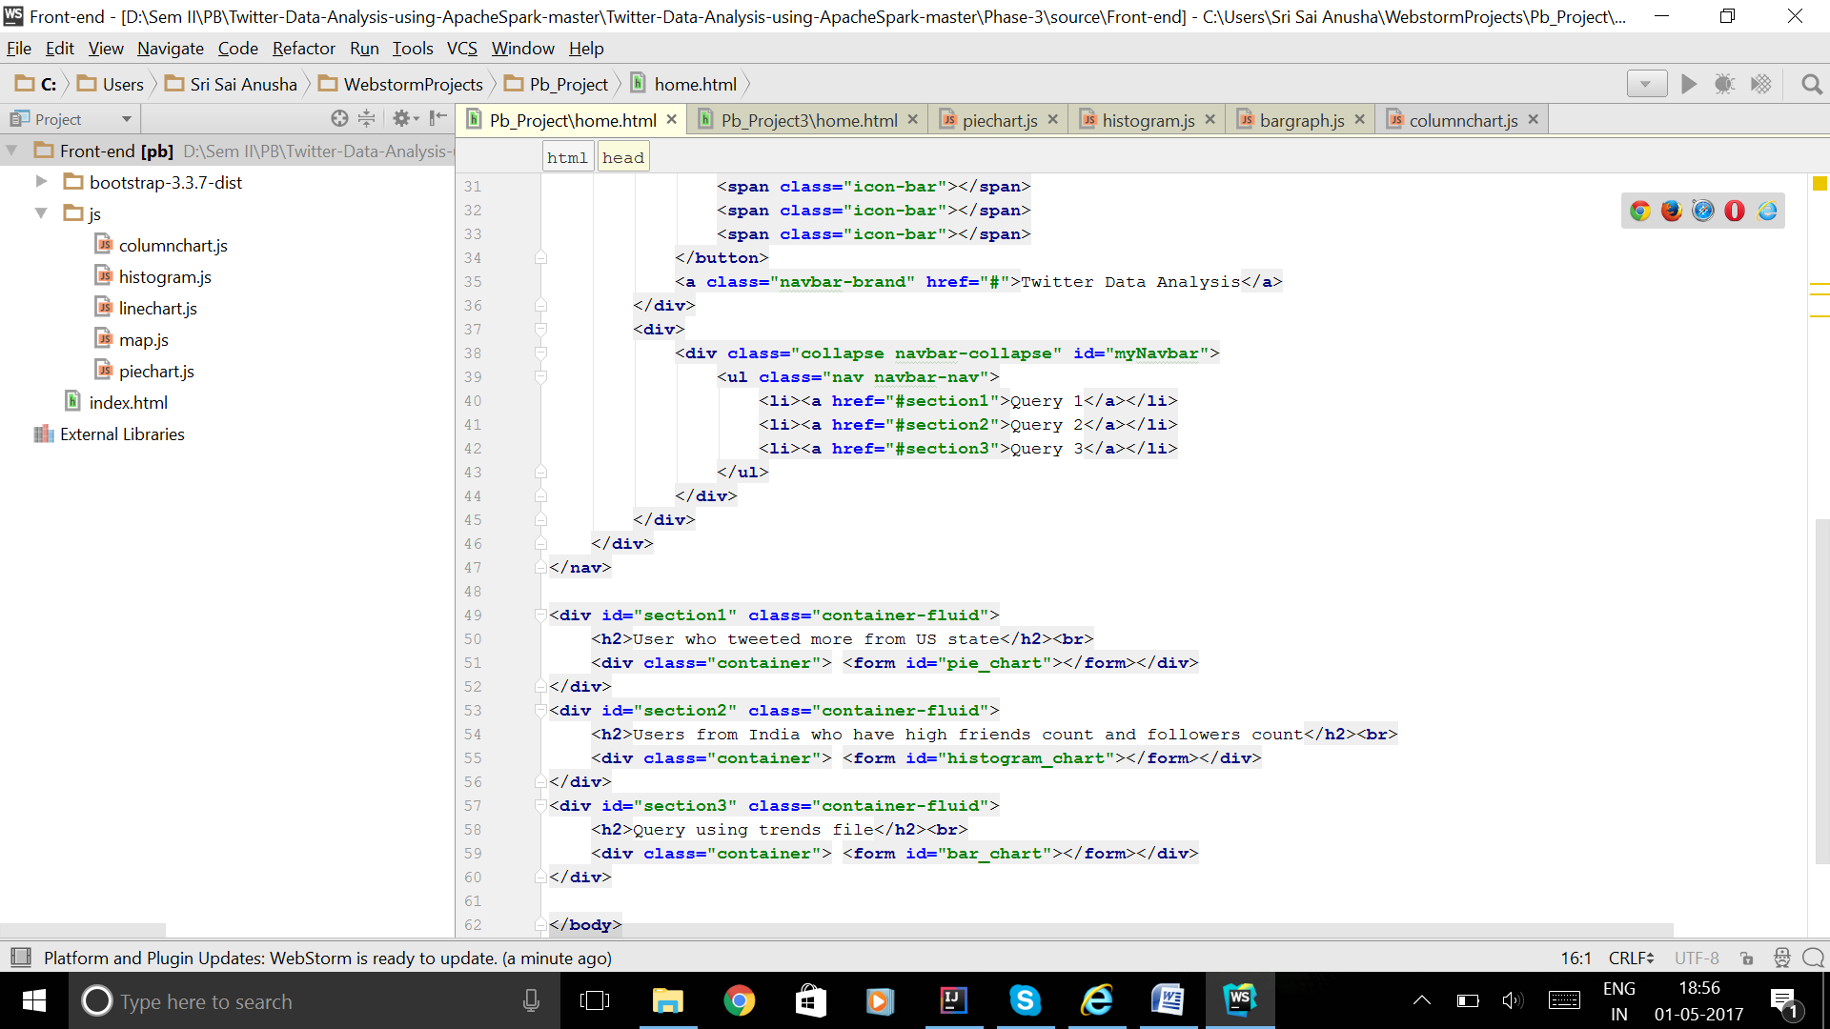

Slide 14
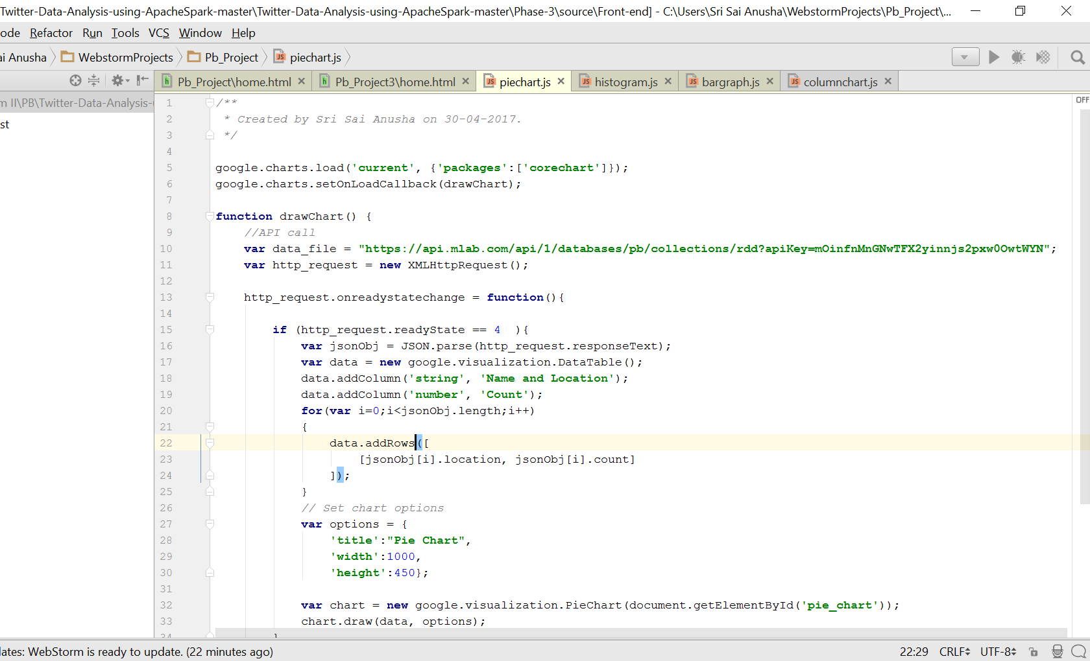
Query 1

Slide 15
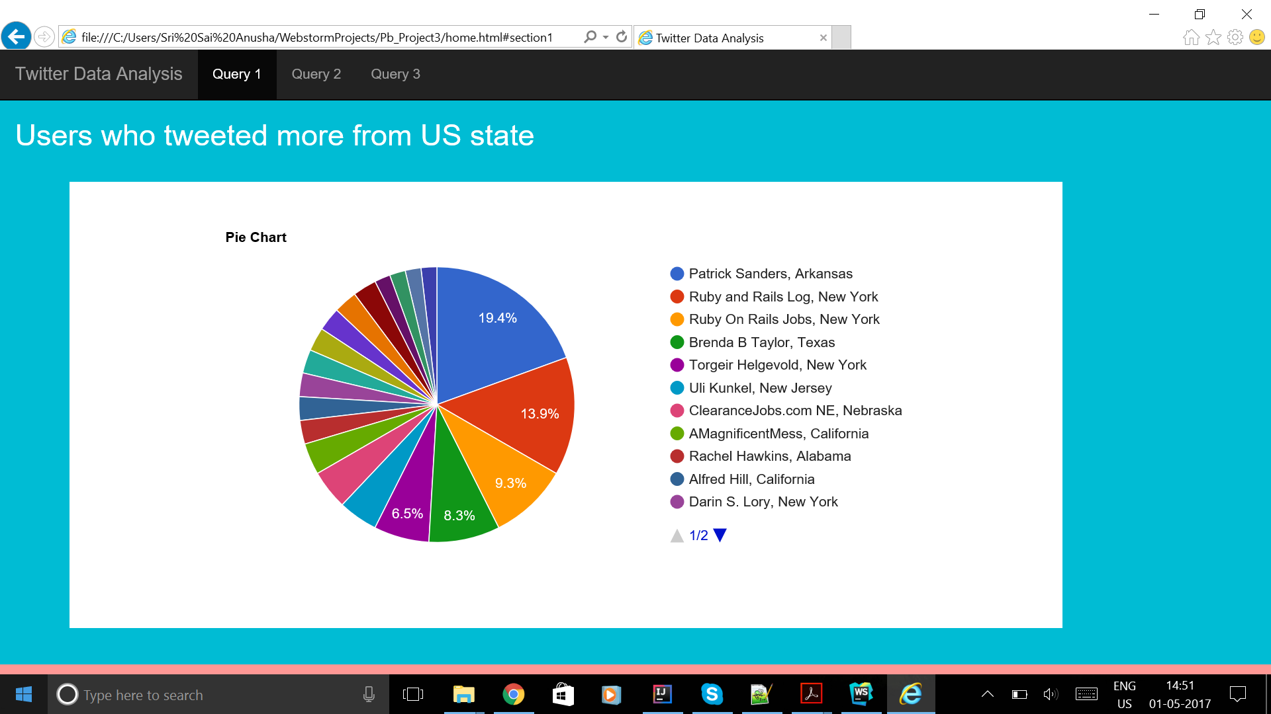
Pie Chart

Slide 16
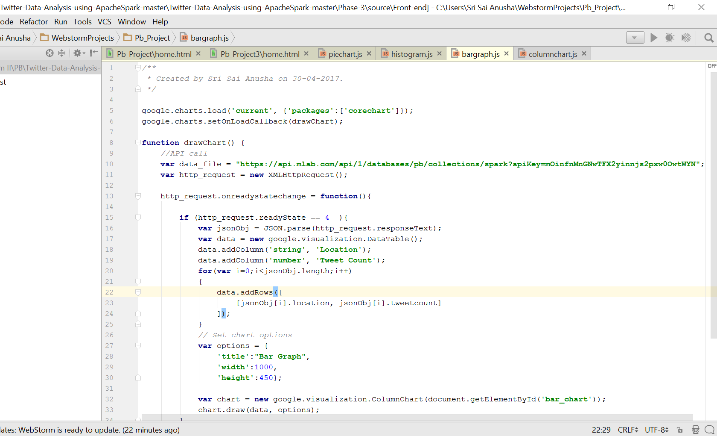
Query 2

Slide 17
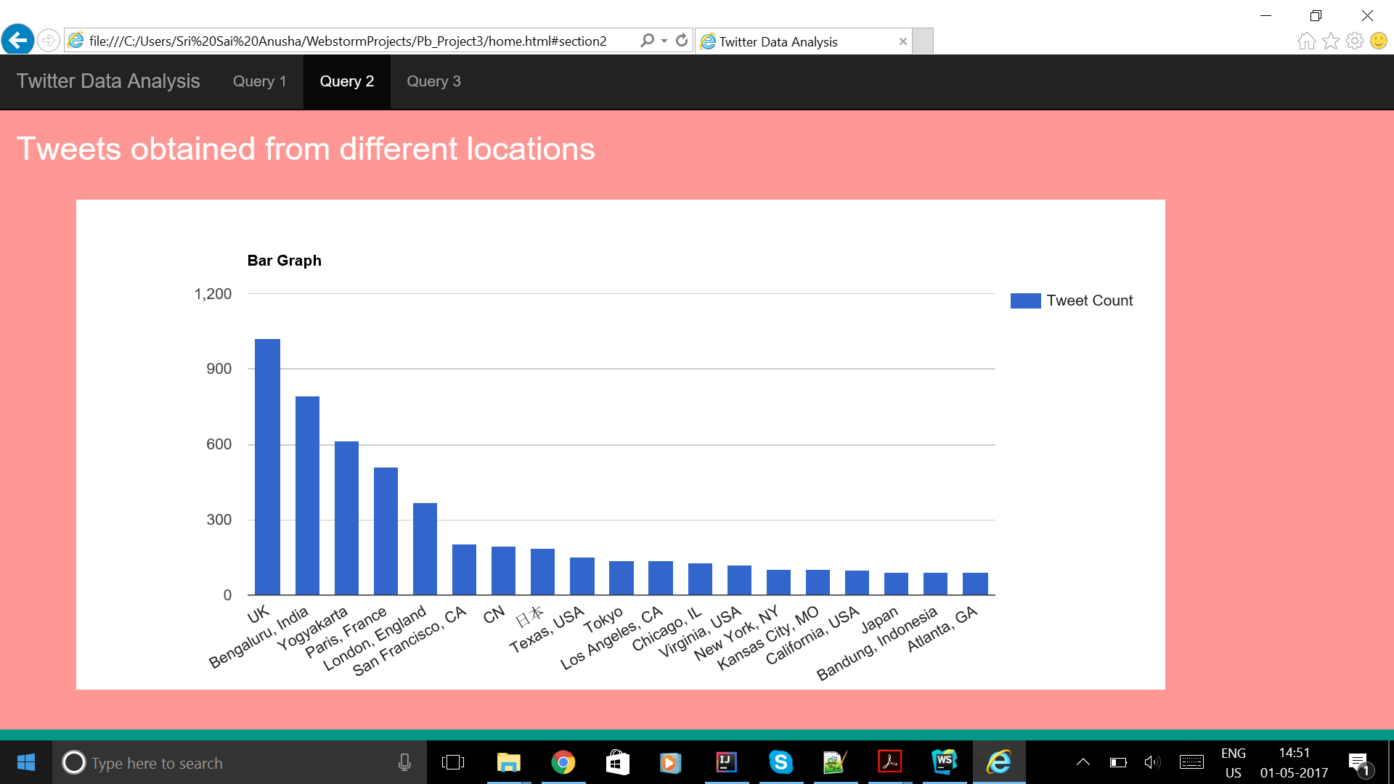
Bar Graph

Slide 18
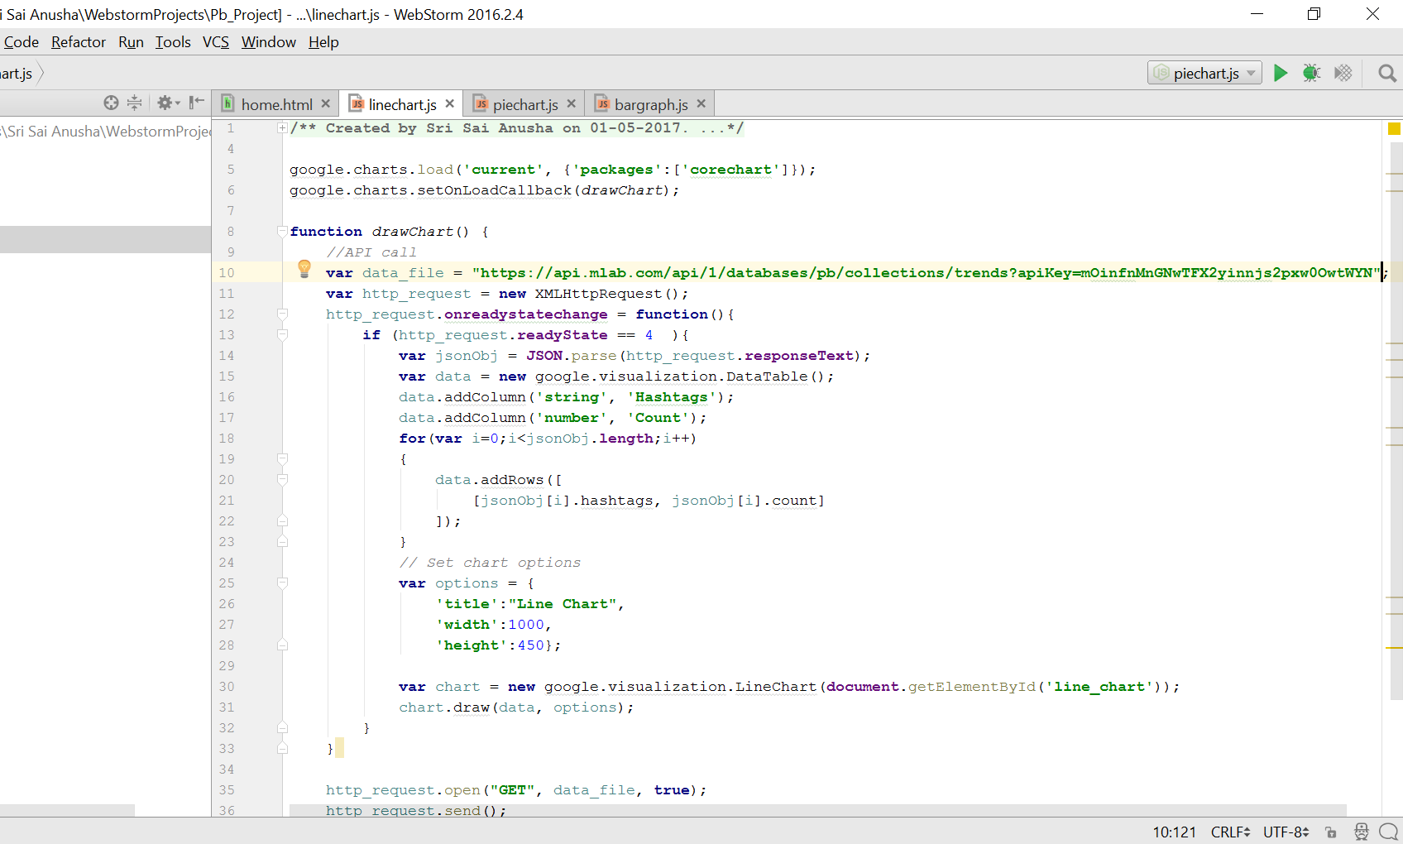
Query 3

Slide 19
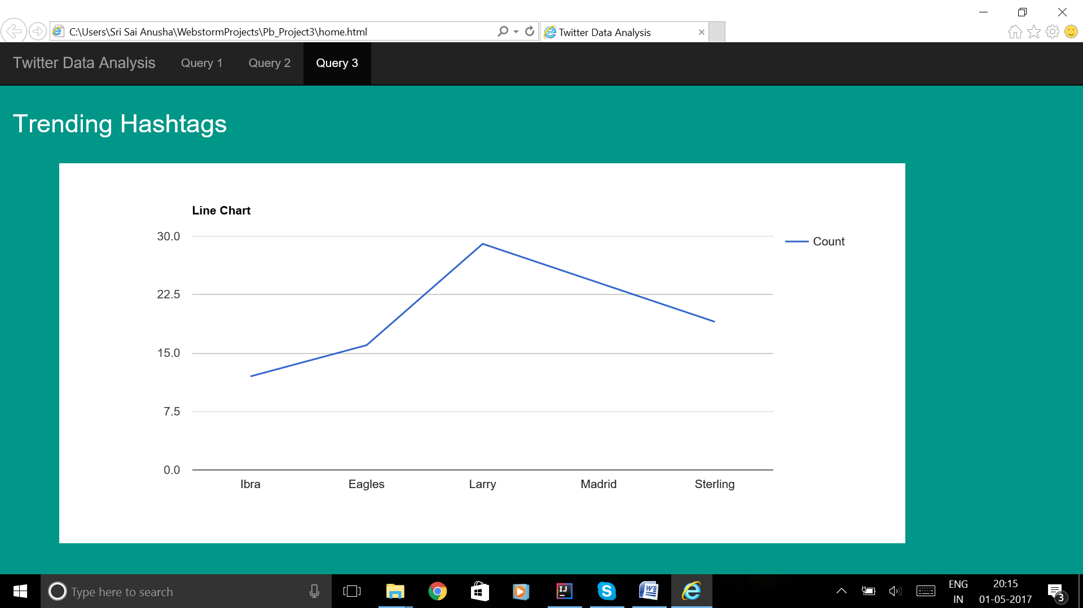
Line Chart

Slide 20
THANK YOU!

